Slide 1
Module 5 IoT Physical Devices and Endpoints: RaspberryPi:

Slide 2
Introduction to RaspberryPi
The Raspberrypi is a series of credit card sized single-board computers developed in the United Kingdom by the Raspberrypi Foundation.
To promote the teaching of basic computer science in schools and developing countries.
Accessories such as keyboard and mouse are not included

Slide 3
Several generations of Raspberrypi have been released.
The first generation (Raspberrypi 1 Model B) was released in February 2012, followed by a simpler and inexpensive model A.
In 2014, the foundation released a board with an improved design in Raspberry 1 Model B+.
The Raspberrypi 2 which added more RAM was released in February 2015.
Raspberrypi 3 model B released in February 2016 is bundled with on-board Wi-Fi and Bluetooth.
Raspberry Pi 4 Model B was released in June 2019 with a 1.5 GHz 64-bit quad core ARM Cortex-A72 processor, on-board 802.11ac Wi-Fi, Bluetooth 5, full gigabit Ethernet

Slide 4
All models feature a Broadcom system on a chip(SoC), which includes an ARM compatible central processing unit (CPU) and an on chip graphics processing unit (GPU, a Video Core IV).
CPU speed ranges from 700 MHz to 1.5GHz for the Pi 4
On board memory range from 256MB to 1GB RAM.
Secure Digital (SD) cards are used to store the operating system and program memory in either the SDHC or Micro SDHC sizes.
Most boards have between one and four USB slots, HDMI and composite video output, and a 3.5 mm phone jack for audio.
Lower level output is provided by a number of GPIO pins which support common protocols like I2C.
The B-models have an Ethernet port and the Pi 3 has on board Wi-Fi 802.11n and Bluetooth.

Slide 5
The Foundation provides Raspbian, a Debian-based Linux distribution for download, as well as third party ubuntu, windows 10 IoT core, RISC OS, and specialized media center distributions.
Python and Scratch are the main programming language, with support for many other languages.

Slide 6
Why RaspberryPi?
Inexpensive, Cross-platform, Simple, clear programming environment, Open source and extensible software.

Slide 7
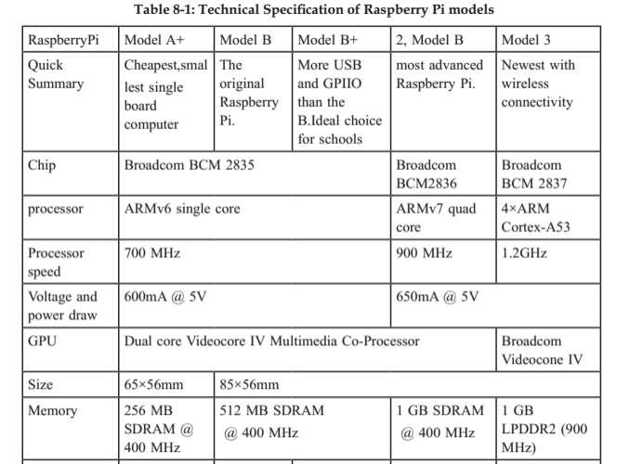

Slide 8
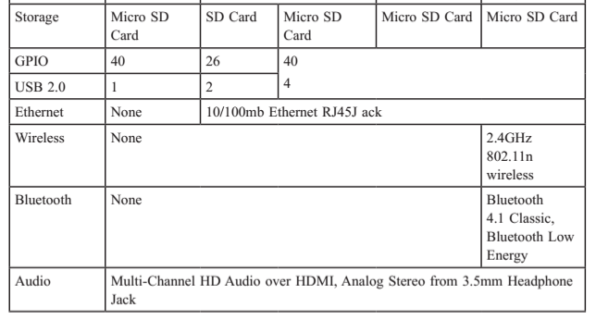

Slide 9
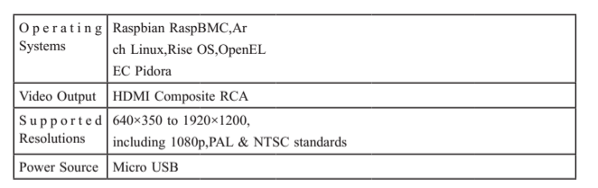

Slide 10
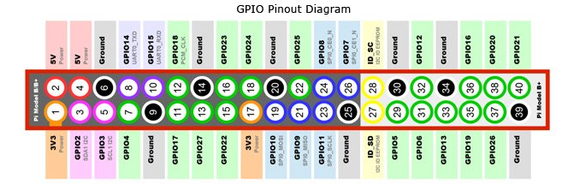
Exploring the Raspberrypi Learning Board Raspberry Pi2 Model B and its GPIO
https://www.jameco.com/Jameco/workshop/circuitnotes/raspberry-pi-circuit-note.html

Slide 11
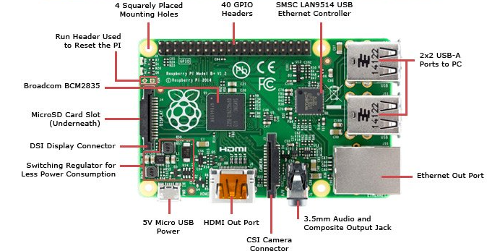
Raspberry Pi2 Model B and its GPIO

Slide 12
Exploring the Raspberrypi Learning Board
Processor
Power Source
SD card
GPIO( General Purpose Input and Output)
DSI Display X
Audio Jack
Status LEDs
Ethernet Port
CSI Connector
JTAG Headers
HDMI

Slide 13
Processor
The Broadcom BCM2835 SoC used in the first generation Raspberrypi, which includes a 700 MHz ARM 1176JZF-S processor, Video Core IV graphics processing unit (GPU) and RAM.
This has a level 1 (L1) cache of 16KB and a level 2 (L2) cache of 128 KB. The level 2 cache is used primarily by the GPU.
The Raspberrypi 2 uses a Broadcom BCM2836 SoC with a 900 MHz 32-bit quad-core ARM cortex A7 processor (as do many current smart phones), with 256KB shared L2 cache.
The Raspberrypi3 uses a Broadcom BCM2837 SoC with a 1.2GHz 64-bit quad core ARM Cortex A53 processor, with a 512KB shared L2 cache.

Slide 14
Power Source
The recommended and easiest way to power the Raspberrypi is via the Micro USB port.
The recommended input voltage is 5V, and the recommended input current is 2A.
Can function on lower current power supplies e.g. 5V @ 1A.
Any excessive use of the USB ports or even heavy CPU/GPU loading can cause the voltage to drop, and instability during use.
The latest versions of the Raspberrypi B+/A+/2 have a “low voltage indicator icon” to notify the user if there is a problem with the power.

Slide 15
SD Card
The Raspberry Pi does not have built in OS and storage. You can plug in an SD card with a linux image with SD card slot. Require atleast an 8GB SD card for New Out-of-the-Box Software.(NOOBS).
GPIO(General Purpose Input Output)
There are four types of pin on Raspberry Pi- true GPIO pins, I2C interface pins, SPI interface pins and serial Rx and Tx pins.
can be controlled by the client at run time.
GPIO capabilities may include:
GPIO pins can be designed to be input or output
GPIO pins can be empowered/crippled
Input values are meaningful (normally high=1, low=0).
output values are writable/meaningful
Input values can frequently be utilized as IRQs.

Slide 16
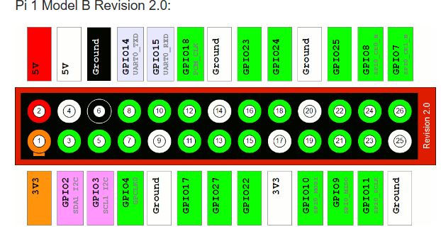
The GPIO.BOARD option specifies that you are referring to the pins by the number of the pin the plug - i.e the numbers printed on the board (e.g. P1) and in the middle of the diagrams below.
The GPIO.BCM option means that you are referring to the pins by the "Broadcom SOC channel" number, these are the numbers after "GPIO" in the green rectangles around the outside

Slide 17
DSI Display X
Raspberrypi Connector S2 is a display serial interface (DSI) for connecting a liquid crystal display (LCD) panel using a 15-pin ribbon cable.
The mobile industry processor interface (MIPI) inside the Broadcom BCM2835 IC feeds graphics data directly to the display panel through this connector.
Audio Jack
A standard 3.5 mm TRS connector is accessible on the RPi for stereo sound.
Any earphone or 3.5mm sound link can be associated straightforwardly.
USB mics or USB sound cards can be utilized.

Slide 18
Status LED
ACT- SD card Access
PWR- 3.3 V power is present
FDX- Full duplex LAN connected
LNK –Link/Network Activity
100- 100Mbit LAN connected

Slide 19
Status LEDs
There are 5 status LEDs on the RPi that demonstrate the status:
― OK - SDCard Access (by means of GPIO16) - named as “OK” on Model B Rev1.0 sheets and “ACT” on Model B Rev2.0 and Model A sheets .
― POWER - 3.3 V Power - named as “PWR” on all the boards
― FDX - Full Duplex (LAN) (Model B) - marked as “FDX” on all the boards
― LNK - Link/Activity (LAN) (Model B) - marked as “LNK” on all the boards
― 10M/100 - 10/100Mbit (LAN) (Model B) - named as “10M” on Model B Rev1.0 boards and “100” on Model B Rev2.0 and Model A boards USB Ports.
There is 1 port on Model A, 2 on Model B and 4 on Model B+ operates at a current upto 100mA.
An external USB powered hub is required to draw current more than 100mA.

Slide 20
Ethernet port:
Ethernet port is accessible on Model B and B+. Comes with RJ45 Ethernet ports. You can connect to ethernet port or WiFi to provide internet connectivity. The Ethernet ports are controlled by Microchip LAN9512 LAN controller chip.
CSI connector (CSI)
Camera Serial Interface is a serial interface outlined by MIPI (Mobile Industry Processor Interface) organization.
CSI interface can be used to connect Camera module to Raspberry Pi.

Slide 21
JTAG headers: (Joint Test Action Group)
is an industry standard for verifying designs and testing printed circuit boards after manufacture.
HDMI:
HDMI port provides both video and audio output. You can connect the Raspberry Pi to a monitor using an HDMI cable

Slide 22
Description of System on Chip (SoC)
An integrated circuit (also known as a "chip") that integrates all or most components of a computer or other electronic system.
These components almost always include a central processing unit (CPU), memory, input/output ports and secondary storage – all on a single substrate or microchip, the size of a coin
SoCs are exceptionally regular in the portable gadgets because of low power utilization.

Slide 23
An SoC comprises of:
Processor cores can be a microcontroller, microprocessor digital signal processor (DSP) or application-specific instruction set processor (ASIP). Multiprocessor SoCs have more than one processor core .
SoC include choice of ROM, RAM, EEPROM and flash memory.
SoCs require timing sources to generate clock signals,
System-on-chip peripherals including counter-timers, real-time timers and power-on reset generators.
External interfaces-for example, USB, FireWire, Ethernet, USART, SPI.
Simple interfaces including ADCs and DACs.
SoCs also include voltage regulators and power management circuits.

Slide 24
Accessories:
Camera
Gertboard
USB Hub

Slide 25
Camera:
The Raspberry Pi camera board contains a 5 Mpixel (v1) & 8Mpixel(v2) sensor, and interfaces through a strip link to the CSI connector on the Raspberry Pi.
In Raspbian, the user must enable the use of the camera board by running Raspi-config and selecting the camera option.
Gertboard
A Raspberry Pi Foundation sanctioned device, designed for educational purposes, that expands the Raspberry Pi's GPIO pins to allow interface with and control of LEDs, switches, analogue signals, sensors and other devices.

Slide 26
USB Hub
Suggested extra for the Pi.
A fueled USB Hub with 7 additional ports is accessible at all online stores.
It is mandatory to utilize a USB Hub to associate outer hard plates or different adornments that draw control from the USB ports, as the Pi can’t offer energy to them.

Slide 27
Raspberry Pi interfaces
Raspberry Pi has serial, SPI and I2C interfaces
Serial:
The serial interface on Raspberry Pi has receive(rx) and transmit(Tx) pins for communication with serial peripherals.
SPI: Serial Peripheral Interface(SPI)
Synchronous serial data protocol used for communicating with one or more peripheral devices. In an SPI connection, there is one master device and one or more peripheral devices.
There are five pins on Raspberry Pi for SPI interface:
MISO(Master In Slave Out): Master line for sending data to the peripherals.
MOSI(Master out Slave In): Slave line for sending data to the master.
SCK(Serial Clock): Clock generated by master to synchronize data transmissions.
CE0(Chip Enable 0): To enable or disable devices.
CE0(Chip Enable 1): To enable or disable devices

Slide 28
I2C (Inter-Integrated Circuit)
I2C interface pins on Raspberry Pi allow you to connect hardware modules. I2C interface allows synchronous data transfer with just two pins-SDA(data line) and SCL(clock line).
The two lines are called SCL and SDA. SCL is the clock line for synchronizing transmission. SDA is the data line through which bits of data are sent or received.

Slide 29
Raspberrypi Operating Systems
Various operating systems can be installed on Raspberrypi through SD cards.
Raspbian, a Debian-based Linux operating system.
Other third party operating systems
Ubuntu MATE,
Snappy Ubuntu Core,
Windows 10 IoT Core,
RISC OS
specialized distributions for the Kodi media center and class room management

Slide 30
Operating Systems (not Linux based):
RISC OS Pi
FreeBSD
NetBSD
Plan 9 from Bell Labs and Inferno
Windows 10 IoT core- smallest edition of Windows 10 offered by Microsoft that runs natively on the RaspberryPi 2.
xv6-is a modern reimplementation of sixth edition Unix OS for teaching purposes, it is ported to RaspberryPi from MIT Xv6, which can boot NOOBs.
Haiku-is an open source BeOS clone that has can be compile for the RaspberryPi and several other ARM boards

Slide 31
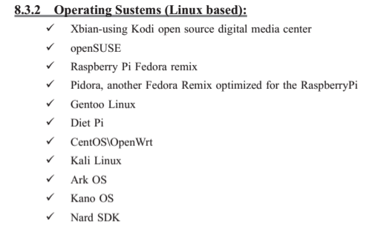

Slide 32
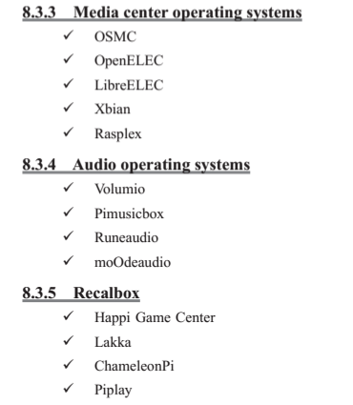

Slide 33
Operating System Setup on Raspberrypi
Preinstalled NOOBS operating system is already available in many authorized as well as independent seller.
There are many other operating system for Raspberrypi in the market like NOOBS, Raspbian and third party operating systems are also available like UBUNTU MATE, OSMC, RISC OS etc.
To setup an operating system we need a SD card with minimum capacity of 8GB.
Download Raspbian:
Download latest Raspbian image from raspberry Pi official website:
https://www.raspberrypi.org/downloads/

Slide 34
Formatting SD card:
Format the SD card before copying NOOBS onto it. To do this
1. Download SD formatter 4.0 from SD Association website for either Windows or Mac.
2. Follow the instructions to install the software.
3. Insert the SD card into the computer or laptops SD card reader and make a note of the drive letter allocated to it
4. In SD formatter, select the drive letter the SD card is and format it.

Slide 35
OS installation:
Follow the steps to install operating system in the SD card.
1. Go to raspberry pi foundation website and click on DOWNLOAD section.
2. Click on NOOBS, then click on the “Download ZIP” button under NOOBS(offline and network install) and select a folder to save this ZIP file
3. Extract all the files from ZIP.
4. Once SD card has been formatted, drag all the files in the extracted NOOBS folder and drop them onto the SD card drive.
5. The necessary files will then be transferred to the SD card. 6. When this process has finished, safely remove the SD card and insert it into the Raspberry Pi.

Slide 36
First Boot:
1. Plug in the keyboard, mouse, and monitor cables.
2. Now plug the USB cable into the Raspberrypi.
3. Now Raspberrypi will boot, and a window will appear with a list of different operating systems that we can install. We recommend using Raspbian- tick the box next to Raspbian and clicking on install.
4. Raspbian will then run through its installation process.
5. When the install process has completed, the Raspberrypi configuration menu (raspi-config) will load. Here we should set the time and date for our region, enable a Raspberrypi camera board, or even create users.

Slide 37
LOGIN Information
The default login for Raspbian is username “pi” with the password “raspberry”.
To load the graphical user interface, type “startx” and press “Enter”.

Slide 38
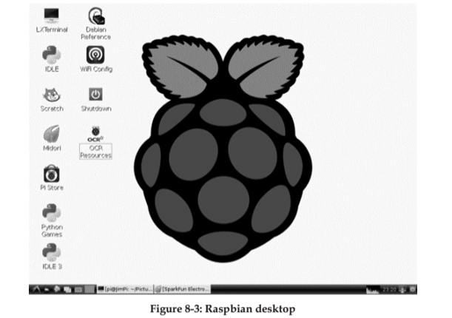

Slide 39
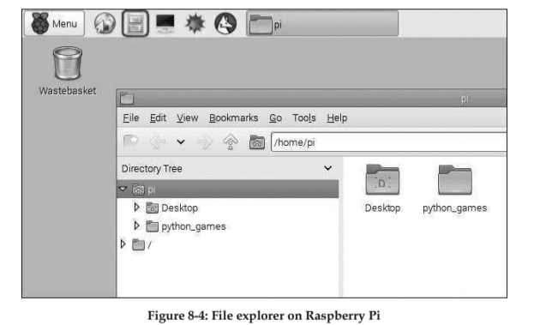

Slide 40
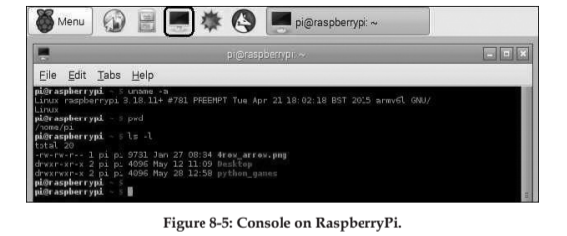

Slide 41
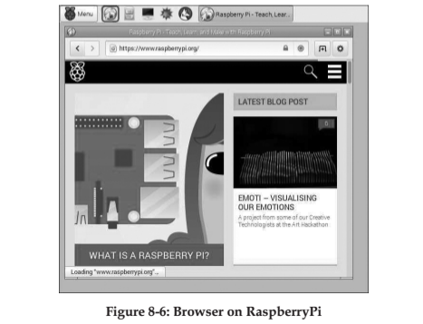

Slide 42
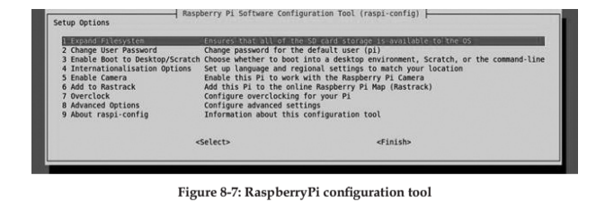

Slide 43
RapberryPi commands
General commands for RaspberryPi:
raspi-config: Configuration settings menu
clear: clears data from terminal.
date: current date.
reboot: Reboot immediately
shutdown –h now: Shutdown system immediately
nano example.txt: Opens the example.txt in the text editor nano.
poweroff: To shutdown immediately.
shutdown –h 01:22: To shutdown at 1:22 AM.
apt-get update: Synchronizes the list of packages on our system to the list in the repositories. Use this before installing new packages to make sure we are installing the latest version
apt-get upgrade: Upgrades all of the software packages we have installed.
startx: Opens the GUI

Slide 44
RapberryPi commands
Directory and File commands:
mkdir new_directory: Creates a new directory named new_directory.
mv new_folder: Moves the file or directory named “new_folder” to a specified location
rm new_file.txt: Deleted the file new_file.txt.
rmdir new_directory: Deletes the directory “new_directory” only if it is empty.
touch new_file.txt: creates a new, empty file named new_file.txt in the current directory.
cat new_file.txt: Displays the contents of the file new_file.txt
cd /xyz/abc: Changes the current directory to the /xyz/abc directory.
ls –l: lists files in the directory.

Slide 45
RapberryPi commands
Networking and Internet Commands:
iwconfig: check which wireless adapter is currently active.
ifconfig: wireless connection status.
ping: tests connectivity between two devices connected on a network.
wget http://www.website.com/new_file.txt: Downloads the file new_file.txt from the web and saves it to the current directory.
nmap: Scans the network and lists connected devices, protocol, port number and other information.
iwlist wlan0 scan: list of currently available wireless networks.

Slide 46
RapberryPi commands
System information commands:
cat /proc/meminfo: shows details about memory
cat /proc/version: shows which version of rsapberrypi we are using.
df –h: shows information about available disk space.
df/: shows how much free disk space is available.
free: shows how much free memory is available.
hostname –l: shows ip address of the raspberrypi.
lsusb; lists the usb hardware connected to raspberrypi.
vcgencmd measure_temp: shows the temperature of the cpu.
vcgencmd get_mem arm && vcgencmd get_mem gpu: shows the memory split between the cpu and gpu.

Slide 47
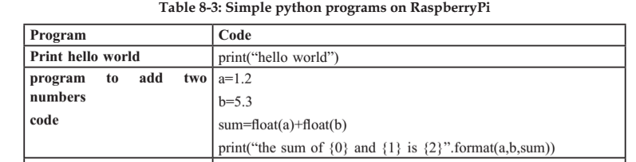
Programming RaspberryPi with Python:

Slide 48



Slide 49
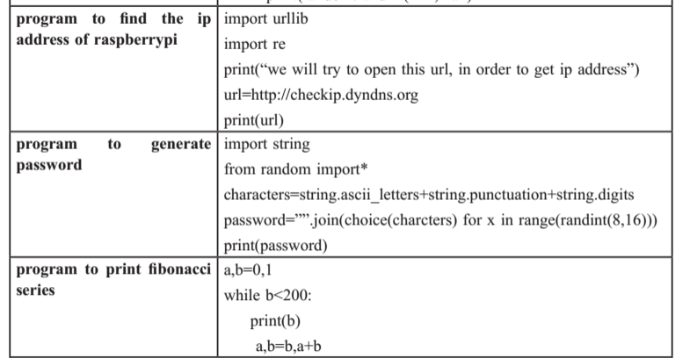

Slide 50
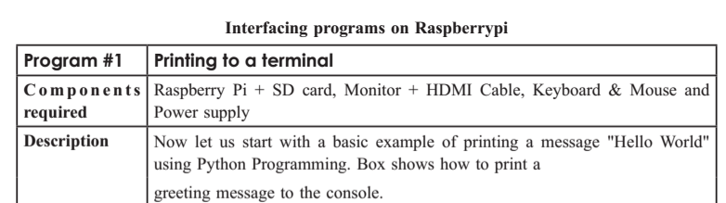

Program 1:Printing to a terminal

Slide 51
Programming RaspberryPi with Python
1. Blinking an LED
2. Push button for physical input
Switch used to control LED
3.Interact with the user
Switch used to control LED depending on user choice

Slide 52
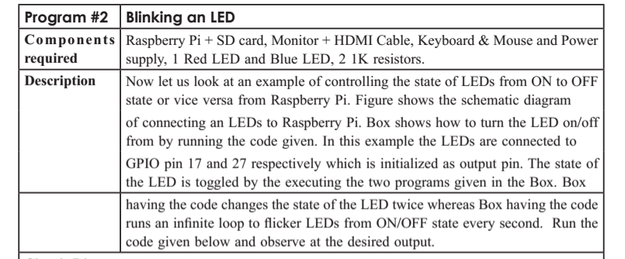
Program 2: Blinking an LED

Slide 53
LED Blink
import RPi.GPIO as GPIO
Tells the Python interpreter (the thing that runs the Python code) that it will be using a ‘library’ that will tell it how to work with the Raspberry Pi’s GPIO pins.
import time
imports the Time library so that we can pause the script later on.
GPIO.setmode(GPIO.BCM) or GPIO.BOARD
Each pin on the Raspberry Pi has several different names, so you need to tell the program which naming convention is to be used.
GPIO.setup(18, GPIO.OUT)
GPIO.output(18, GPIO.HIGH)
This turns the GPIO pin ‘on’. What this actually means is that the pin is made to provide power of 3.3volts. This is enough to turn the LED in our circuit on.
GPIO.output(18, GPIO.LOW)
This turns the GPIO pin ‘off’, meaning that the pin is no longer supplying any power.

Slide 54
Exploring the Raspberrypi Learning Board Raspberry Pi2 Model B and its GPIO
https://www.jameco.com/Jameco/workshop/circuitnotes/raspberry-pi-circuit-note.html

Slide 55
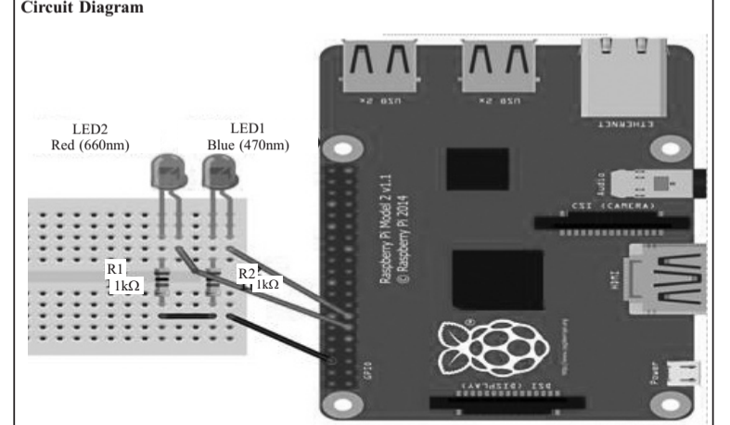

Slide 56
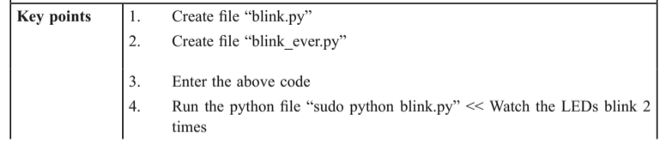

Slide 57
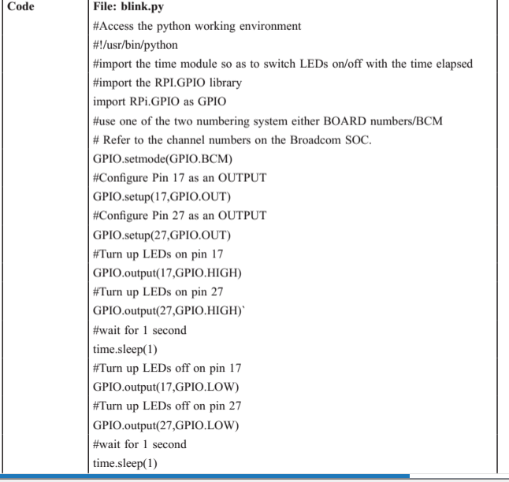

Slide 58

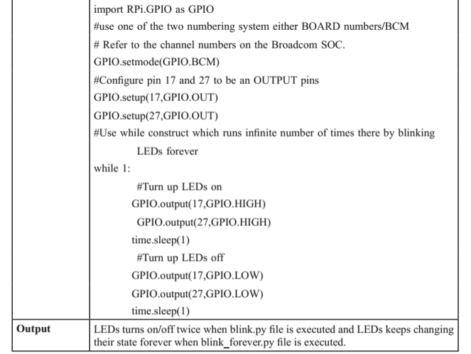

Slide 60
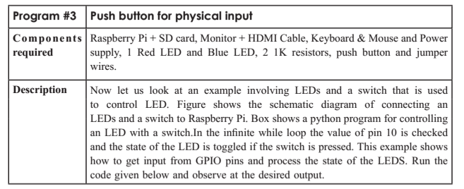

Slide 61
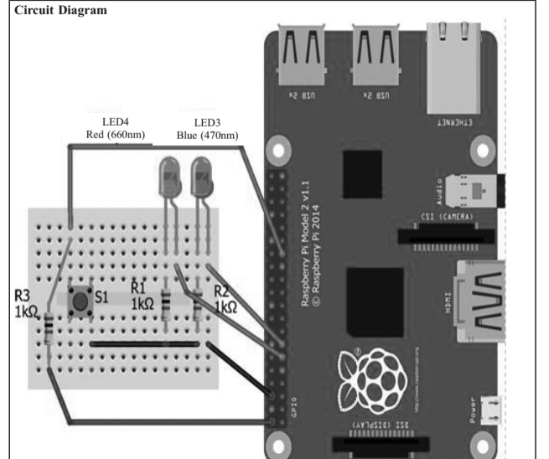

Slide 62
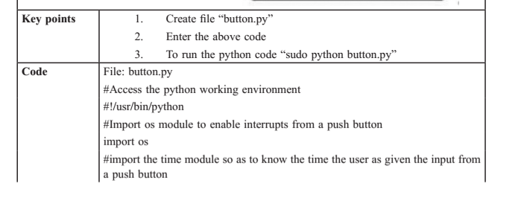

Slide 63
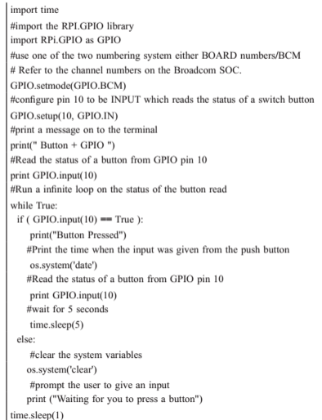

Slide 65
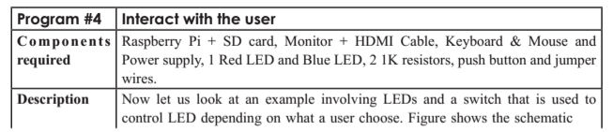
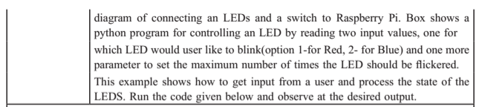

Slide 66
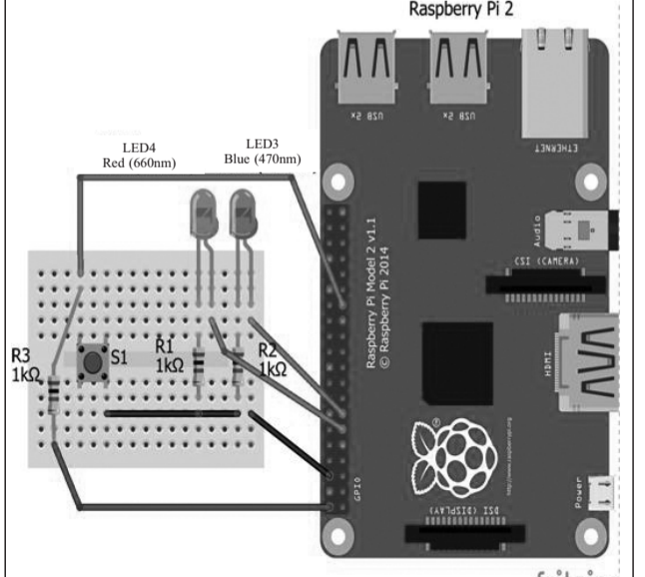

Slide 67
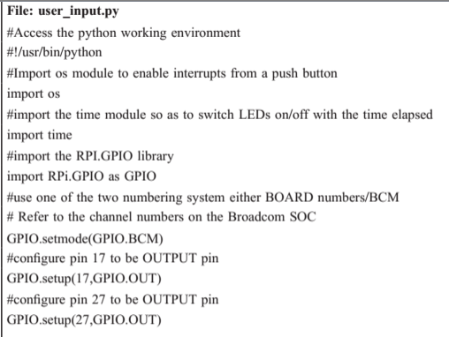

Slide 68
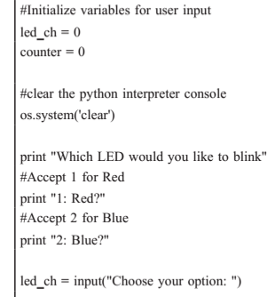

Slide 69

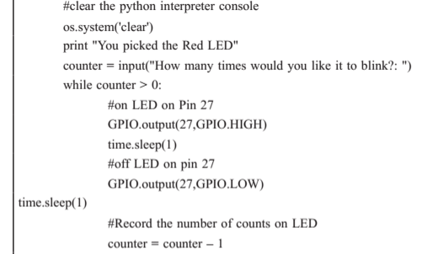

Slide 70
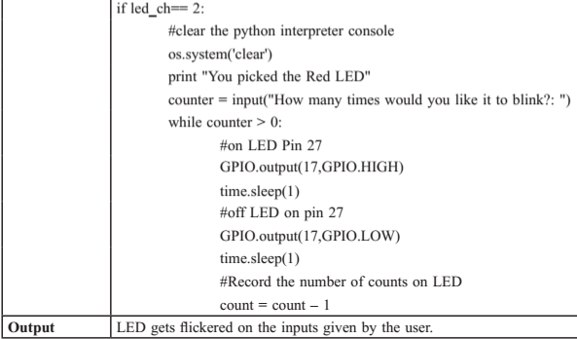

Slide 71
Program #5: Piezo Buzzer
Components Required
Raspberry Pi + SD card, Monitor + HDMI Cable, Keyboard & Mouse and Power supply, jumper wires, Breadboard, buzzer.
Description
A Piezo buzzer used to beep a number of times the user choose.
connect an piezo buzzer to pin 23.
A python program for controlling an piezo buzzer by reading an input value which runs over a loop to beep number of times the user has choose.

Slide 72
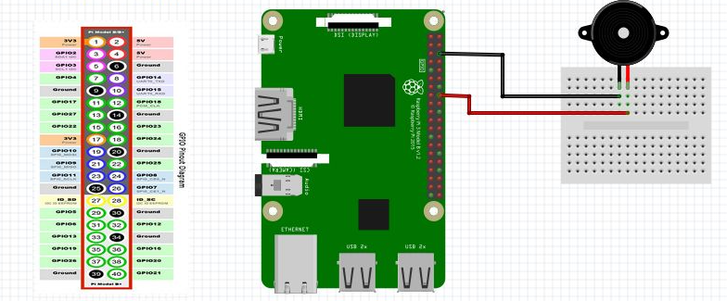

Slide 73
Initialize pin 23 as an output pin with GPIO.setup( ) function.
In the main loop, you make a beep sound with GPIO.output( ) function and "pause" the program for 0.1 second with sleep( ) function.

Slide 74
Code
import os
import time
import RPi.GPIO as GPIO
GPIO.setmode(GPIO.BCM)
GPIO.setwarnings(False)
GPIO.setup(23,GPIO.OUT)
loop_counter = 0

Slide 75
def morsecode ():
#Dot Dot Dot
GPIO.output(23,GPIO.HIGH)
time.sleep(.1)
GPIO.output(23,GPIO.LOW)
time.sleep(.1)
GPIO.output(23,GPIO.HIGH)
time.sleep(.1)
GPIO.output(23,GPIO.LOW)
time.sleep(.1)
GPIO.output(23,GPIO.HIGH)
time.sleep(.1)

Slide 76
#Dash Dash Dah
GPIO.output(23,GPIO.LOW)
time.sleep(.2)
GPIO.output(23,GPIO.HIGH)
time.sleep(.2)
GPIO.output(23,GPIO.LOW)
time.sleep(.2)
GPIO.output(23,GPIO.HIGH)
time.sleep(.2)
GPIO.output(23,GPIO.LOW)
time.sleep(.2)
GPIO.output(23,GPIO.HIGH)
time.sleep(.2)
GPIO.output(23,GPIO.LOW)
time.sleep(.2)

Slide 77
os.system('clear’)
print "Morse Code" loop_count = input("How many times would you like SOS to loop?:")
while loop_count > 0:
loop_counter = loop_counter - 1
morsecode ()

Slide 78
Program #6: Temperature Sensor-DS18B20
Components Required
Raspberry Pi + SD card, Monitor + HDMI Cable, Keyboard & Mouse and Power supply, 1 DS18B20 temperature sensor.
Description
An DS18B20 temperature sensor which reads out a temperature and records on to a terminal.
A python program which records the temperature read by DS18B20 temperature sensor.
An infinite loop runs over the sensor which records a temperature every second.

Slide 79
About DS18B20
A commonly used temperature sensor providing 9 bit to 12 bit digital Celsius temperature measurements.
The DS18B20 communicates with the “One-Wire” communication protocol, a proprietary serial communication protocol that uses only one wire to transmit the temperature readings to the microcontroller.
The DS18B20 can be operated in what is known as parasite power mode.
Normally the DS18B20 needs three wires for operation: the Vcc, ground, and data wires. In parasite mode, only the ground and data lines are used, and power is supplied through the data line.

Slide 80
A 64 bit ROM stores the device’s unique serial code. This 64 bit address allows a microcontroller to receive temperature data from a virtually unlimited number of sensors at the same pin.
The address tells the microcontroller which sensor a particular temperature value is coming from.
The Raspberry Pi has drivers for one wired devices to be connected to GPIO pin-4 by default.
https://electrosome.com/ds18b20-sensor-raspberry-pi-python/
https://www.circuitbasics.com/raspberry-pi-ds18b20-temperature-sensor-tutorial/

Slide 81
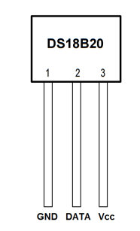
DS18B20

Slide 82
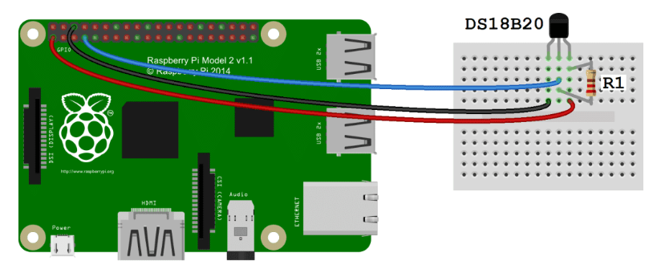

Slide 83
Enable the One-Wire Interface
modprobe
used to add a loadable kernel module to the Linux kernel
sudo modprobe w1-gpio
sudo modprobe w1-therm
Change directories to the /sys/bus/w1/devices directory by entering: cd /sys/bus/w1/devices
Now enter ls to list the devices:
28-000006637696 w1_bus_master1 is displayed in my case.
Now enter cd 28-XXXXXXXXXXXX (change the X’s to your own address)
For example, I would enter: cd 28-000006637696
Enter cat w1_slave which will show the raw temperature reading output by the sensor:

Slide 84
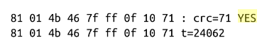
Output
The displayed data consist of two lines – first line representing the value read and CRC check and second line temperature in Celsius x 1000.

Slide 85
Code
import os # import os module
import glob # import glob module
import time # import time module
#initialize the device
# load one wire communication device kernel modules
os.system('modprobe w1-gpio’)
os.system('modprobe w1-therm’)
base_dir = '/sys/bus/w1/devices/’ # point to the address
# find device with address starting from 28*
device_folder = glob.glob(base_dir + '28*')[0]
device_file = device_folder + '/w1_slave’ # store the details
def read_temp_raw():
f = open(device_file, 'r’)
lines = f.readlines() # read the device details
f.close()
return lines

Slide 86
def read_temp():
lines = read_temp_raw()
while lines[0].strip()[-3:] != 'YES’: # ignore first line
time.sleep(0.2)
lines = read_temp_raw()
equals_pos = lines[1].find('t=‘) # find temperature in the details
if equals_pos != -1:
temp_string = lines[1][equals_pos+2:]
temp_c = float(temp_string)/ 1000.0 # convert to Celsius
temp_f = temp_c * 9.0/ 5.0 + 32.0 # convert to Fahrenheit
return temp_c, temp_f
while True:
print(read_temp())
time.sleep(1)

Slide 87
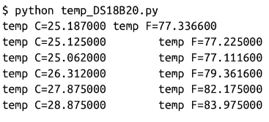
Output
Current Room Temperature is recorded.

Slide 88
Program #7: Light sensor –LDR(Light Dependent Resistor)
Components Required
Raspberry Pi + SD card, Monitor + HDMI Cable, Keyboard & Mouse, Power supply, jumper wires, Breadboard, LDR Light Dependent resistor, 1uF Capacitor
Description
An LDR sensor reads the intensity of light and records it an text file.
A python program which records the intensity of light to a text file.
An infinite loop runs over the sensor which records intensity of light with date and time stamps every second.

Slide 89

LDR

Slide 90
LDR(Photo Resistor)
A photo conductive sensor.
It is a variable resistor that changes it’s resistance in a proportion to the light exposed to it. Its resistance decreases with the intensity of light.
As the capacitor gradually charges, the voltage that passes through the circuit and to the GPIO pin rises. Once the capacitor is charged to a certain point, it's voltage rises above 1.4 volts and the Raspberry Pi will sense that GPIO pin 4 is HIGH.
If the resistance of the sensor increases, the capacitor will charge more slowly and the circuit will take more time to reach 1.4 volts.
The script essentially counts how long it takes for pin 4 to turn High and then uses this measurement to calculate the resistance of the Photoresistor.

Slide 91
The Raspberry Pi will repeatedly display the resistance of the photoresistor.
If you place your finger over the photoresistor, the resistance will increase.
If you shine a bright light on the photoresistor, the resistance will decrease.
https://pimylifeup.com/raspberry-pi-light-sensor/

Slide 92
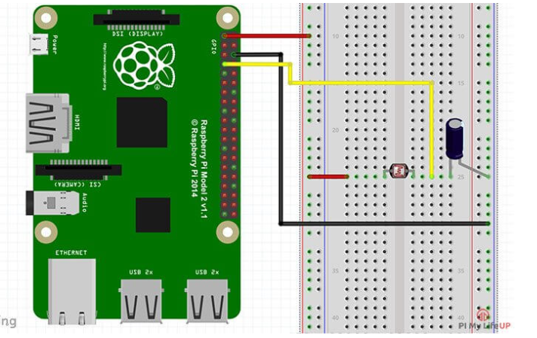

Slide 93
Circuit Diagram
Connect one side of LDR sensor to 3.3V (Red Wire) and other side of LDR is connected to both GPIO pin 4 (yellow Wire) and 1uF Capacitor
Connect other side of capacitor to negative. (Black Wire)

Slide 94
Code
import os
import datetime
import time
import RPi.GPIO as GPIO
GPIO.setmode(GPIO.BCM)
def RCtimes(RCpins):
readings = 0
GPIO.setup(RCpins, GPIO.OUT)
GPIO.output(RCpins, GPIO.LOW)
time.sleep(.1)

Slide 95
GPIO.setup(RCpins, GPIO.IN)
#iterates 1 miliseconds over one cycle
while (GPIO.input(RCpins) == GPIO.LOW):
readings += 1
return readings
while True:
GetDateTime = datetime.datetime.now().strftime("%Y-%m-%d %H:%M:%S")\
LDRReading = RCtimes(4)
print RCtimes(4)
#Open a file
fo = open("/home/pi/10x10/foo.txt", "wb") # write only binary
fo.write (GetDateTime)
LDRReading = str(LDRReading)
fo.write ("\n")
fo.write (LDRReading)
#Close opend file
fo.close()
time.sleep(1)

Slide 96
RCtimes function returns a count which is proportional to light level.
In this functions, LDR pin is set to output and low and then to input.
At this point, capacitor starts charging through the resistor until input pin reads high(this happens when capacitor voltage becomes greater than 1.4V)
Counter stopped when input reads high.
The final count is proportional to light level as greater the amount of light, smaller is the LDR resistance and greater is the time taken to charge the capacitor
Output:
Intensity of the light in the room is recorded on to a terminal as well as to text file.

Slide 97
Program #8: Passive infrared Sensor
Components Required
Raspberry Pi + SD card, Monitor + HDMI Cable, Keyboard & Mouse and Power supply, jumper wires, Breadboard, PIR(Passive Infrared sensor) sensor, Buzzer.
Description
An PIR sensor detects the motion of an object.
A python program detects the motion of an object and triggers a buzzer and print message as "Motion detected".
An infinite loop runs over the PIR sensor which waits for any of the movements across its boundary.

Slide 98
PIR
PIR (passive infrared) motion sensor detects any movement of objects, human or animals.
Sensor has three pins. Power (VCC), Ground (GND) and output (OUT) pin which gives logic high if motion is detected.
https://www.hackster.io/hardikrathod/pir-motion-sensor-with-raspberry-pi-415c04

Slide 99
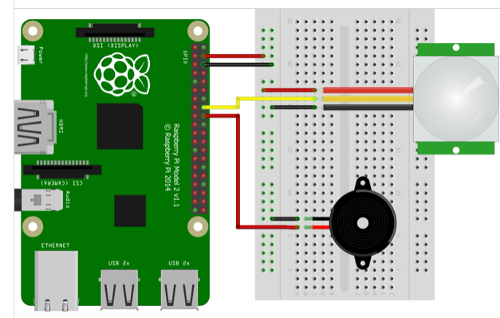
Circuit Diagram

Slide 100
import RPi.GPIO as GPIO
import time
GPIO.setmode(GPIO.BCM)
GPIO.setup(23, GPIO.IN) #PIR
GPIO.setup(24, GPIO.OUT) #Buzzer
try:
time.sleep(2) # to stabilize sensor
while True:
if GPIO.input(23): #If there is a movement, PIR sensor gives input to GPIO 23
GPIO.output(24, True)
time.sleep(0.5) #Buzzer turns on for 0.5 sec
GPIO.output(24, False)
print("Motion Detected...")
time.sleep(5) #to avoid multiple detection
time.sleep(0.1) #loop delay, should be less than detection delay
except:
GPIO.cleanup()

Slide 101
Connecting Raspberry Pi via SSH (Secure Shell)
You can access the command line of a Raspberry Pi remotely from another computer or device using SSH.
SSH connection can’t open programs that use a graphical interface
The Raspberry Pi will act as a remote device: you can connect to it using a client on another machine.
https://magpi.raspberrypi.org/articles/ssh-remote-control-raspberry-pi
https://www.raspberrypi.org/documentation/remote-access/ssh/

Slide 102
Connecting Raspberry Pi via SSH
Step 1. Set up your local network and wireless connectivity
Step 2. Enable SSH
Step 3: Activate SSH Client in Windows
Step 4: Connect via SSH
Step 5: Use PuTTY on a Windows PC

Slide 103
1. Set up your local network and wireless connectivity
Make sure your Raspberry Pi is properly set up and connected.
Ifconfig command or hostname –I to display IP address.
Note down the IP address of your Pi

Slide 104
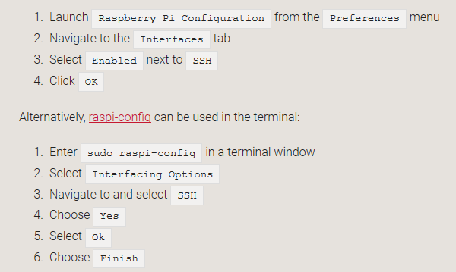
2. Enable SSH
Alternatively, use systemctl to start the services
sudo systemctl enable ssh
sudo systemctl start ssh

Slide 105
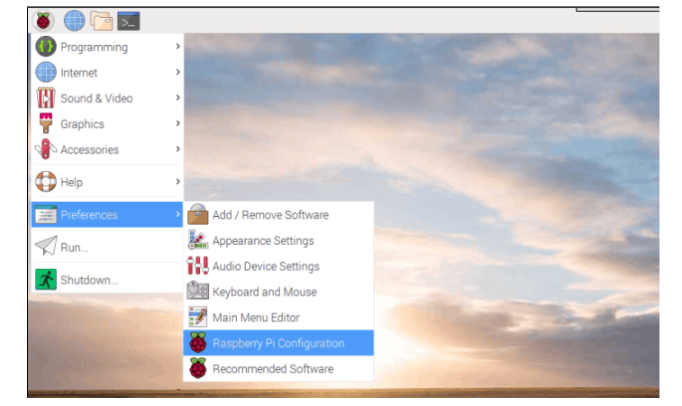

Slide 106
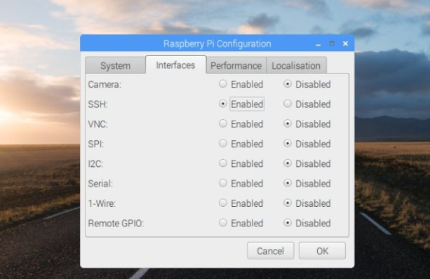

Slide 107
Step 3: Activate SSH Client in Windows
Linux and macOS both support SSH out-of-the-box; skip ahead to Step 3 if you are using one of those operating systems
Windows 10 supports SSH, but you need to activate it. Click on Search and look for ‘Manage Optional Features’. Click it in Search to open the Settings window.
Click ‘Add a feature’ and wait for the list of Optional Features to load. Scroll down the list to Open SSH Client (Beta). Click Install.

Slide 108
Step 4: Connect via SSH
Open Command Prompt on a Windows PC, or a Terminal window in Linux or macOS.
Enter this command:
ssh pi@192.168.0.41
Step 5: Use PuTTY on a Windows PC
On older PCs you’ll need to install PuTTY. Download the putty.exe file and click Run.
Enter the IP address of your Raspberry Pi in the ‘Host Name (Or IP Address)’ field. Don’t change the ‘Port’ field. Click Open. You will get a PuTTY ‘Security Alert’ field. Click Yes. The terminal window displays ‘login as:’ Enter pi and press RETURN. Now enter the password for your Raspberry Pi.

Slide 109
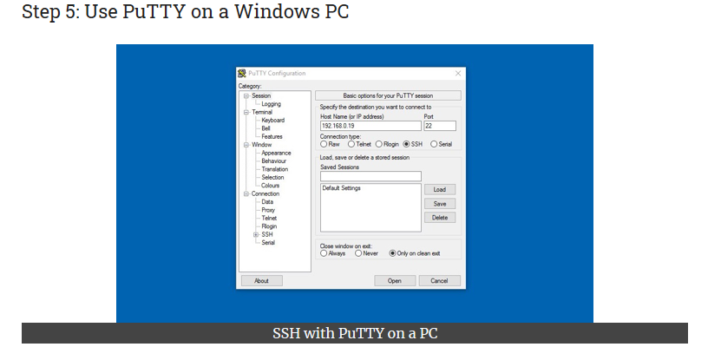

Slide 110
Remote Access to RaspberryPi
Using VNC
VNC Server is included with your Raspberry Pi.
You will also need a VNC Viewer application for the Windows.
Run the following commands to make sure you have the latest version:
sudo apt-get update
sudo apt-get install realvnc-vnc-server
VNC Server is included with Raspbian but you still have to enable it.
Select Menu > Preferences > Raspberry Pi Configuration > Interfaces and make sure VNC is set to Enabled
Alternatively, run the command, sudo raspi-config, navigate to Interfacing Options > VNC and select Yes

Slide 111
Establishing a direct connection
Direct connections are quick and simple providing you’re joined to the same private local network as your Raspberry Pi.
On your Raspberry Pi, discover its private IP address by double-clicking the VNC Server icon on the taskbar and examining the status dialog.

Slide 112
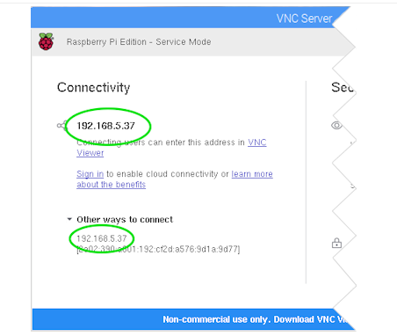

Slide 113
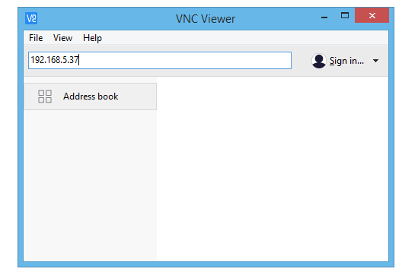
On the device you will use to take control, run VNC Viewer and enter the IP address in the search bar:

Slide 114
Establishing a cloud connection
Sign up for a RealVNC account by entering your email address.
On your Raspberry Pi, select Licensing from the VNC Server status menu, choose Sign in to your RealVNC account, and enter your new account email and password.

Slide 115
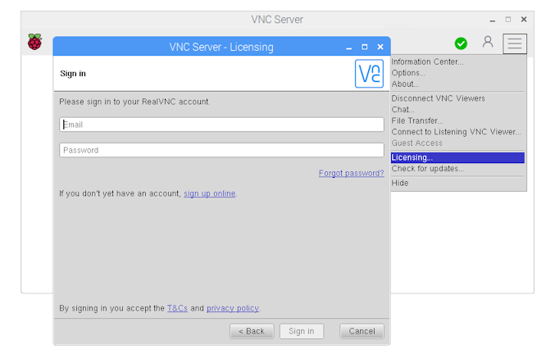

Slide 116
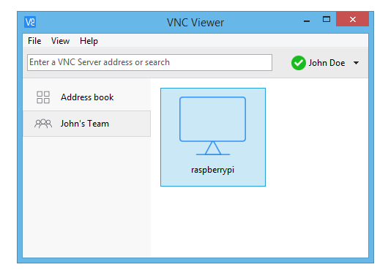
On the device you will use to take control, run VNC Viewer and sign in using the same account credentials.
In VNC Viewer, a connection to your Raspberry Pi automatically appears under the name of your team. Simply tap or double-click to connect:

Slide 117
Authenticating to VNC Server
Enter the user name and password you normally use to log on to your user account on the Raspberry Pi.
By default, these credentials are pi and raspberry.

